Slide 1


AI IN ACADEMIA
2024
SUMMIT

Slide 2

WELCOME TO
USING AI TO GENERATE CASE STUDIES
AI IN ACADEMIA
2024
SUMMIT

Slide 3
Poll
What challenges do you have using case studies?

Slide 4
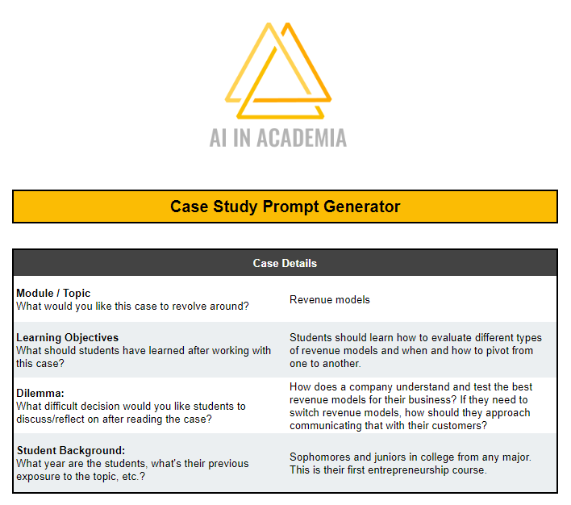
Case study prompt generator
Link in Chat

Slide 5
Agenda
Creating Case Studies with AI
Announcements
Exercise: 30-Minute Prep

Slide 6


Announcement #1
Full Access Ticketholders
Thank You
1-on-1 AI Chat
Justin Wilcox
Doan Winkel
AI in Academia
John Carroll University
Technical ?’s
School, Policy ?’s

Slide 7

Announcement #2
Pricing
Free This Summer
Unlimited Fall Prep
Post-Aug pricing TBD

Slide 8
30-Minute Prep
Summer/Winter is here
How can AI help you prep?

Slide 9
30-Minute Prep
Course Prep
Course outlines
Lesson Plans
Lesson Plan
Game
Games
Blooket
Bingo
Jeopardy
Rubric
AI Assessment
Case Study
Case Studies

Slide 10
30-Minute Prep
Put it all together
Module
Game
Lesson Plan
Case Study
Rubric

Slide 11
30-Minute Prep
Put it all together
Module
Intro
Apply
Reflect
Assess

Slide 12
30-Minute Prep
Put it all together
Module
Intro
Apply
Reflect
Assess

Slide 13
30-Minute Prep
Put it all together
Module
Intro
Apply
Reflect
Assess

Slide 14
30-Minute Prep
Put it all together
Module
Intro
Apply
Reflect
Assess

Slide 15
30-Minute Prep
Put it all together
Module
Game
Intro
Case Study
Apply
Lesson Plan
Reflect
Rubric
Assess

Slide 16
30-Minute Prep
What’s the best tool?
Module
Case Study
Rubric
Game
Lesson Plan
Intro
Apply
Reflect
Assess
?
Notes:
OBS:Circle - Slides + Cam - 720p

Slide 17
30-Minute Prep
What’s the best tool?
Module
Intro
Apply
Reflect
Assess
?
Case Study
Rubric
Game
Lesson Plan

Slide 18
30-Minute Prep
What’s the best tool?
Module
Intro
Apply
Reflect
Assess
?
Game
Rubric
Case Study
Lesson Plan

Slide 19
30-Minute Prep
What’s the best tool?
Module
Intro
Apply
Reflect
Assess
?
Game
Lesson Plan
Rubric
Case Study

Slide 20
30-Minute Prep
What’s the best tool?
Module
Intro
Apply
Reflect
Assess
?
Game
Lesson Plan
Case Study
Rubric

Slide 21
30-Minute Prep
What’s the best tool?
Module
Intro
Apply
Reflect
Assess
?
Game
Lesson Plan
Case Study
Rubric

Slide 22
30-Minute Prep
What’s the best tool?
Module
Intro
Apply
Reflect
Assess
Game
Lesson Plan
Case Study
Rubric

Slide 23
30-Minute Prep
Put it all together
Module
Game
Lesson Plan
Case Study
Rubric

Slide 24
30-Minute Prep
15 Minutes to Build a Module
Module
Game
Lesson Plan
Case Study
Rubric

Slide 25

Breakout rooms
Your chance to build a module
Notes:
OBS:Split - Slides + Cam - 720p

Slide 26
Virtual TA
AI optimized for higher ed
12 weeks old
(Very) Beta
Notes:
OBS:Split - Slides + Cam - 720p

Slide 27



BREAKOUTS
Highly recommend you join
Share Best Practices
You’ll get to. . .
Learn how others are using AI
Build a module
Ask about your concerns
Please THANK your facilitator!

Slide 28
BREAKOUTS
Highly recommend you join
Share Best Practices
But if you don’t . . .
Want to be on camera
Have a stable connection
Want to participate
Please don’t join
In our main room I’ll be offering tech support

Slide 29
30-Minute Prep
15 Minutes to Build a Module
Module
Game
Lesson Plan
Case Study
Rubric
What’s the other 15 minutes for?

Slide 30
30-Minute Prep
15 Minutes to Build a Module
Module
Game
Lesson Plan
Case Study
Rubric
Checking for accuracy

Slide 31
Using
Free through Summer​
Prep for Fall
Invite only
www.MeetFlex.ai

Slide 32
THANK YOU
USING AI TO GENERATE CASE STUDIES
AI IN ACADEMIA
2024
SUMMIT

