Slide 1


AI IN ACADEMIA
2024
SUMMIT

Slide 2

WELCOME TO
CREATING ENGAGING GAMES WITH AI
AI IN ACADEMIA
2024
SUMMIT

Slide 3
AGenda
Why we play games?​
Show you 3 different games
Create your own

Slide 4

Replace slides
Engage students
Flex & ChatGPT can help

Slide 5
CHAT STORM
Foster reflection & discussion
1
Don’t hit “enter” until I tell you to
2
Type your answer in the chat…but don’t hit enter
3
I’ll count down “3, 2, 1, enter”
QUESTION:
WHEN CAN YOU USE BLOOKET?

Slide 6
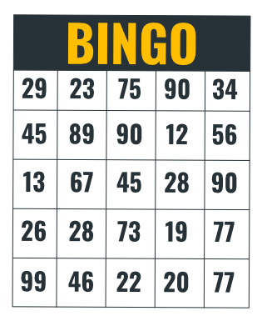
Game #2:
bingo
5-in-a-row wins!

Slide 7
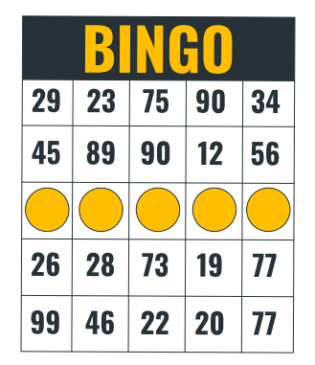
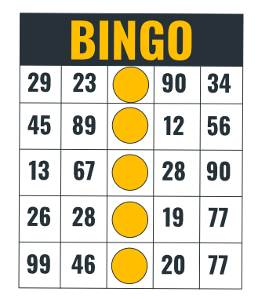
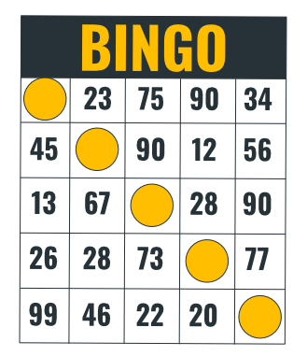
Game #2:
bingo
5-in-a-row wins!

Slide 8
Game #2:
bingo
Replace
numbers
with...
?’s

Slide 9
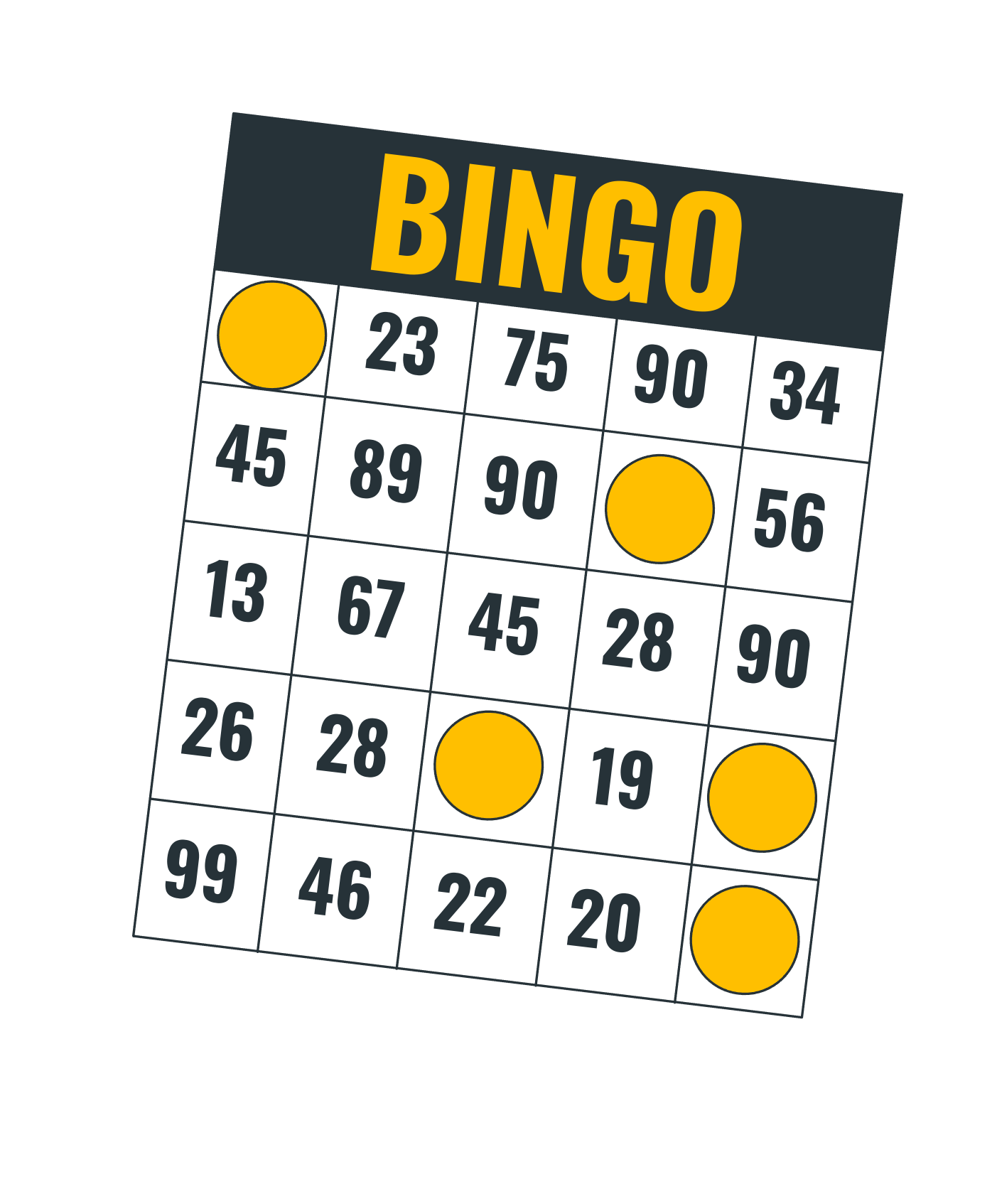
Bingo
Replace slides
Foster discussion
Flex & ChatGPT can help

Slide 10
CHAT STORM
Foster reflection & discussion
1
Don’t hit “enter” until I tell you to
2
Type your answer in the chat…but don’t hit enter
3
I’ll count down “3, 2, 1, enter”
QUESTION:
WHEN CAN YOU USE BINGO?

Slide 11

Game #3:
HINT
In this game, players
are given the answers
and they must provide
the correct questions

Slide 12



Slide 13
World History

Slide 14
Panel
Ancient Civilizations
Explorers and Discoveries
Revolutionary Leaders
Industrial Revolution
World Wars
Space Exploration
$200
$200
$200
$200
$200
$200
$400
$400
$400
$400
$400
$400
$600
$600
$600
$600
$600
$600
$800
$800
$800
$800
$800
$800
$1000
$1000
$1000
$1000
$1000
$1000
Exit

Slide 15
The ancient civilization known for building pyramids along the Nile River.
Ancient Civilizations · $200
Notes:
What is Egypt?

Slide 16
The civilization that developed the first system of writing known as cuneiform.
Ancient Civilizations · $400
Notes:
What is Sumer?

Slide 17
The ancient civilization famous for the creation of the Great Wall.
Ancient Civilizations · $600
Notes:
What is China?

Slide 18
The civilization that built Machu Picchu in the Andes Mountains.
Ancient Civilizations · $800
Notes:
What is the Inca Empire?

Slide 19
The civilization known for the city of Petra carved into rose-red cliffs.
Ancient Civilizations · $1000
Notes:
What is the Nabateans?

Slide 20
The explorer who reached the Americas in 1492, mistakenly thinking he had reached Asia.
Explorers and Discoveries · $200
Notes:
Who is Christopher Columbus?

Slide 21
The Portuguese explorer who led the first expedition to circumnavigate the globe.
Explorers and Discoveries · $400
Notes:
Who is Ferdinand Magellan?

Slide 22
The Viking explorer who is believed to have reached North America around 1000 AD.
Explorers and Discoveries · $600
Notes:
Who is Leif Erikson?

Slide 23
The Spanish conquistador who conquered the Inca Empire in Peru.
Explorers and Discoveries · $800
Notes:
Who is Francisco Pizarro?

Slide 24
The British explorer who discovered the Hawaiian Islands in 1778.
Explorers and Discoveries · $1000
Notes:
Who is Captain James Cook?

Slide 25
The leader of the American Revolution and the first President of the United States.
Revolutionary Leaders · $200
Notes:
Who is George Washington?

Slide 26
The French military leader who became Emperor and conquered much of Europe.
Revolutionary Leaders · $400
Notes:
Who is Napoleon Bonaparte?

Slide 27
The leader of the Haitian Revolution, the only successful slave revolt in history.
Revolutionary Leaders · $600
Notes:
Who is Toussaint Louverture?

Slide 28
The liberator of South America, known as the 'George Washington of South America'.
Revolutionary Leaders · $800
Notes:
Who is Simón Bolívar?

Slide 29
The leader of the Mexican War of Independence against Spanish colonial rule.
Revolutionary Leaders · $1000
Notes:
Who is Miguel Hidalgo?

Slide 30
The invention that revolutionized transportation by steam power.
Industrial Revolution · $200
Notes:
What is the steam engine?

Slide 31
The process of making steel from iron, leading to stronger and cheaper production.
Industrial Revolution · $400
Notes:
What is the Bessemer process?

Slide 32
The system of manufacturing that uses interchangeable parts for efficiency.
Industrial Revolution · $600
Notes:
What is the assembly line?

Slide 33
The communication invention that transformed long-distance communication.
Industrial Revolution · $800
Notes:
What is the telegraph?

Slide 34
The economic system based on private ownership and free market competition.
Industrial Revolution · $1000
Notes:
What is capitalism?

Slide 35
The event that sparked World War I, the assassination of Archduke Franz Ferdinand.
World Wars · $200
Notes:
What is the assassination in Sarajevo?

Slide 36
The German military strategy of quickly defeating France before turning to Russia in WWI.
World Wars · $400
Notes:
What is the Schlieffen Plan?

Slide 37
The battle that marked the turning point in favor of the Allies in World War II.
World Wars · $600
Notes:
What is the Battle of Stalingrad?

Slide 38
The code-breaking operation that helped the Allies win crucial battles in WWII.
World Wars · $800
Notes:
What is Bletchley Park?

Slide 39
The Japanese attack on this U.S. naval base brought the U.S. into WWII.
World Wars · $1000
Notes:
What is Pearl Harbor?

Slide 40
The first human to journey into outer space, aboard Vostok 1 in 1961.
Space Exploration · $200
Notes:
Who is Yuri Gagarin?

Slide 41
The U.S. space agency responsible for the Apollo moon-landing missions.
Space Exploration · $400
Notes:
What is NASA?

Slide 42
The first spacecraft to reach the moon with humans on board.
Space Exploration · $600
Notes:
What is Apollo 11?

Slide 43
The Soviet space station that orbited Earth from 1986 to 2001.
Space Exploration · $800
Notes:
What is Mir?

Slide 44
The first American woman in space, flying aboard the Space Shuttle Challenger in 1983.
Space Exploration · $1000
Notes:
Who is Sally Ride?

Slide 45
Winner!

Slide 46
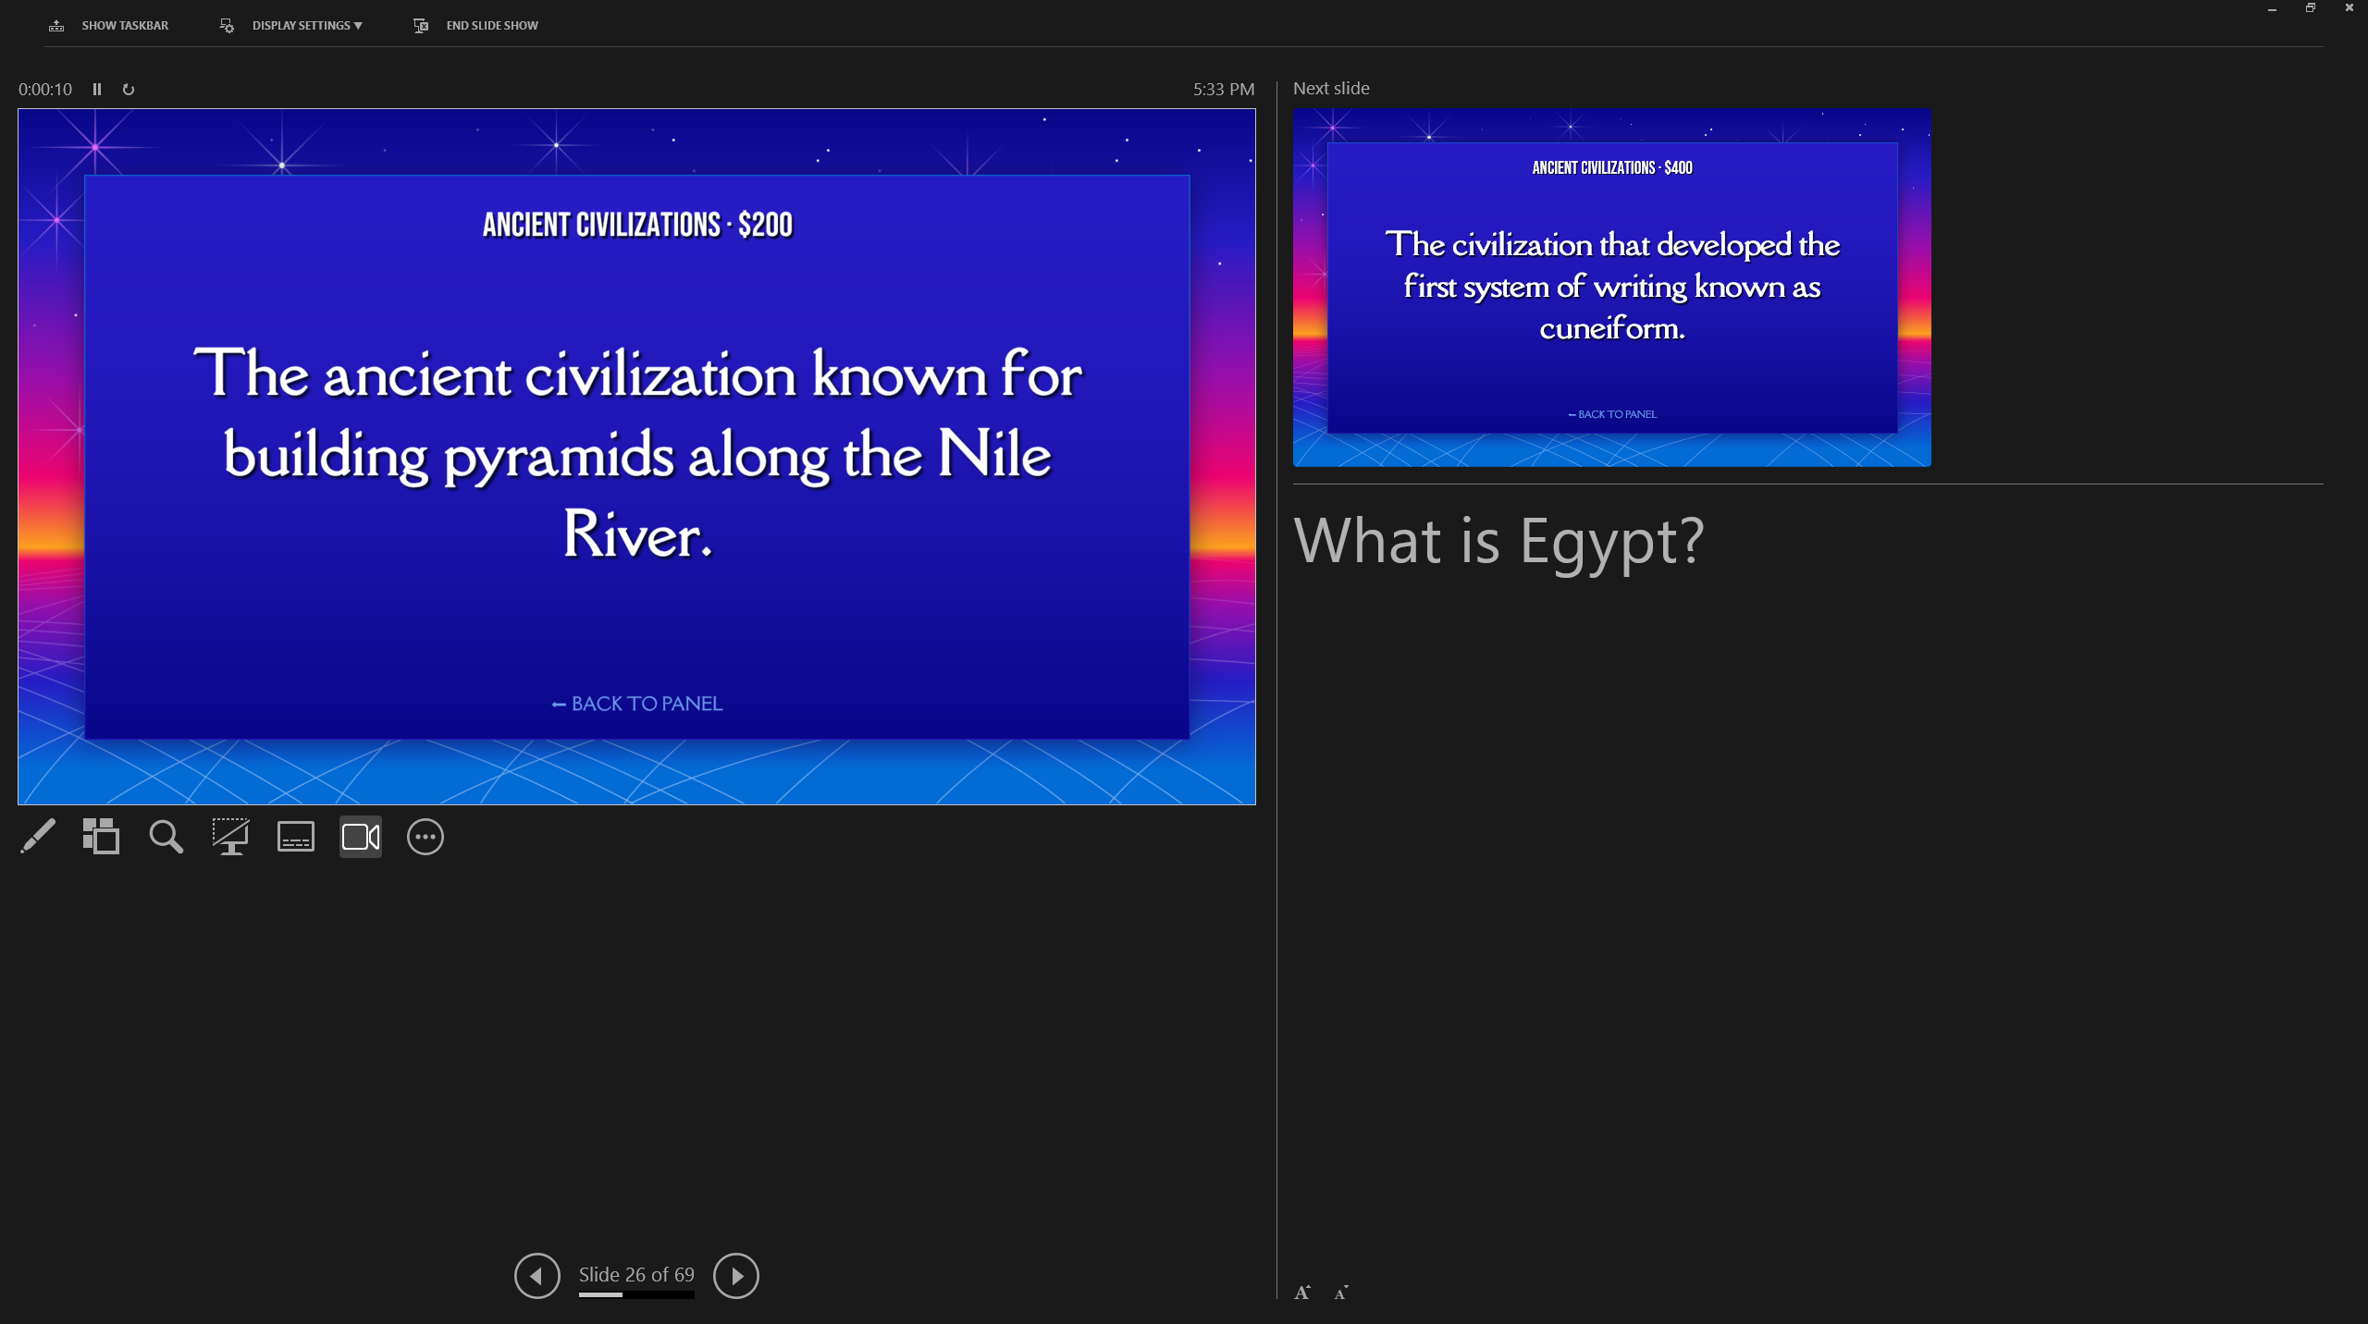
Students see ?’s
You see answers
Presenter view

Slide 47
Make Your Own?
ChatGPT
- Copy and paste into each slide
Flex
- Built automatically
- Extremely flexible

Slide 48
Recap module/course
Team competition
Flex will help you

Slide 49
CHAT STORM
Foster reflection & discussion
1
Don’t hit “enter” until I tell you to
2
Type your answer in the chat…but don’t hit enter
3
I’ll count down “3, 2, 1, enter”
QUESTION:
WHEN CAN YOU USE JEOPARDY?

Slide 50

Virtual TA
AI optimized for higher ed
10 weeks old
(Very) Beta

Slide 51
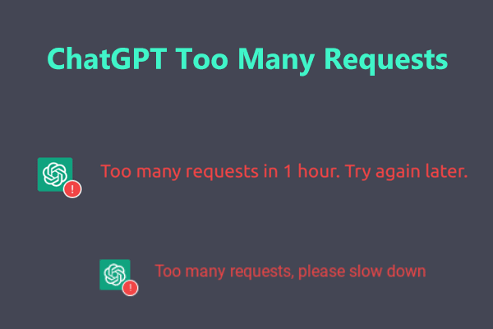

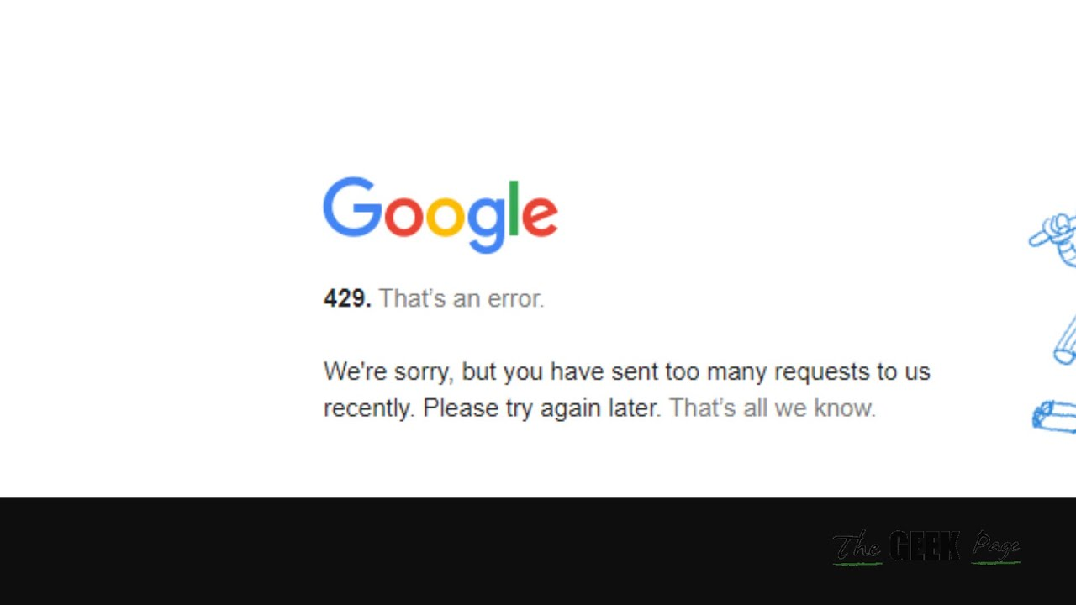
Using flex
“Hug of Death”

Slide 52
Using flex
Avoiding Hug of Death
Email after workshop
Play with samples

Slide 53
Using flex
Avoiding Hug of Death
Email after workshop
Play with samples

Slide 54
Using flex
Avoiding Hug of Death
Email after workshop
Play with samples
Ask breakout facilitator
Crash Flex after ?’s

Slide 55
Using
Free during the summit​
How much will it cost?
The more people use it,
the less it will cost

Slide 56
share
Invite others to the summit
AIinAcademia.org
Free use of Flex
Lesson prep
Creating in-class games
Grading
Case study development

Slide 57
THANK YOU
CREATING ENGAGING GAMES WITH AI
AI IN ACADEMIA
2024
SUMMIT

