Slide 1


AI IN ACADEMIA
2024
SUMMIT

Slide 2

WELCOME TO
HALVE YOUR GRADING TIME WITH A VIRTUAL TA
AI IN ACADEMIA
2024
SUMMIT

Slide 3
Poll
Anonymous:
Which grading challenges
resonate with you?

Slide 4
Grading with ai
ChatGPT
Pros
Good feedback
Sensible scoring
Cons
Difficult to customize
Feedback isn’t “LMS-ready”
Save time?

Slide 5
Grading with ai
ChatGPT
Flex
Pros
Customizable
“LMS-ready” feedback
Saves time
Cons
We want your feedback

Slide 6
Agenda
How AI can help grade
How AI grading can help you…
engage your students
Addressing AI grading objections

Slide 7
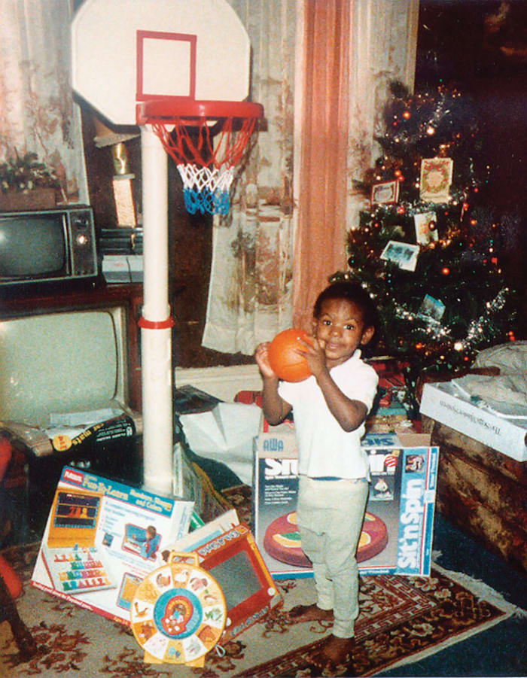
Who’s this?
Started playing 5th grade in Ohio
Professional basketball player
One of the best of all time
Lebron james

Slide 8
Imagine lebron

Slide 9

Come back next week
and I’ll tell you if your shot went in.

Slide 10
I wanted this to feel familiar…
I wanted this to feel like school.
Why?

Slide 11
Without a feedback loop…
Started playing 5th grade in Ohio
Professional basketball player
One of the best of all time
…Engagement declines

Slide 12

Without a feedback loop…
AI help here?
Student submits low-quality work
Get feedback a week later
Don’t iterate
Poor grade
Engagement declines

Slide 13
Without a feedback loop…
AI help here?
Student submits low-quality work
Get feedback immediately
Iterate
Improve grade
Engagement increase?

Slide 14
today
Submit
Get Grade

Slide 15

Tomorrow
Submit
Get Grade
Pre-assessment
See Improvement
Immediate Feedback
Increases engagement
Iterate
Increases quality

Slide 16
Engagement loop
Submit
Get Grade
See Improvement
Immediate Feedback
Increases engagement
Iterate
Increases quality

Slide 17
Agenda
How AI can help grade
How AI grading can help you…
engage your students
Addressing AI grading objections

Slide 18
CHAT STORM
AI Grading Objections
1
Don’t hit “enter” until I tell you to
2
Type your answer in the chat…but don’t hit enter
3
I’ll count down “3, 2, 1, enter”

Slide 19
CHAT STORM
AI Grading Objections
1
Don’t hit “enter” until I tell you to
QUESTION:
WHAT’S THE BIGGEST OBJECTION
YOU’LL GET TO USING
AI GRADING?

Slide 20
“THAT’S YOUR JOB”
“You get paid to grade”
“It’s part of my responsibilities”
“Why am I paying you tuition if AI is doing the grading?”
CHAT STORM:
HOW WOULD YOU RESPOND?

Slide 21

Imagine 2 pilots
I get paid to fly...
I get paid to fly safely...
Pilot a
Pilot B
…so I never use autopilot.
…so I use autopilot whenever feasible.
* Fatal airline accidents have decreased 99.75% since the advent of autopilot. Source

Slide 22
which do you want?
I get paid to fly...
I get paid to fly safely...
Pilot a
Pilot B
…so I never use autopilot.
…so I use autopilot whenever feasible.
* Fatal airline accidents have decreased 99.75% since the advent of autopilot. Source

Slide 23
Our job is…to teach
Grade
Lecture
Test
LIKE AUTOPILOT DOES FOR PILOTS
If AI can help us teach better
we should use it.

Slide 24
“if I can’t…you can’t”
If students can’t use AI, instructors shouldn’t either
CHAT STORM:
HOW WOULD YOU RESPOND?
Describe how your AI policy helps you serve your students

Slide 25
Agenda
How AI can help grade
How AI grading can help you…
engage your students
Addressing AI grading objections

Slide 26

Using
Free during the summit​
How much will it cost?
The more people use it,
the less it will cost

Slide 27
Next steps
Pilot Engagement Loops
Free use of Flex
Lesson prep
Creating in-class games
Grading
Case study development

Slide 28
THANK YOU
HALVE YOUR GRADING TIME WITH A VIRTUAL TA
AI IN ACADEMIA
2024
SUMMIT

