Slide 1

WELCOME TO
USING AI TO TEACH
CUSTOMER INTERVIEWING
Justin Wilcox
Notes:
OBS:Split - Slides + Cam - 720p

Slide 2
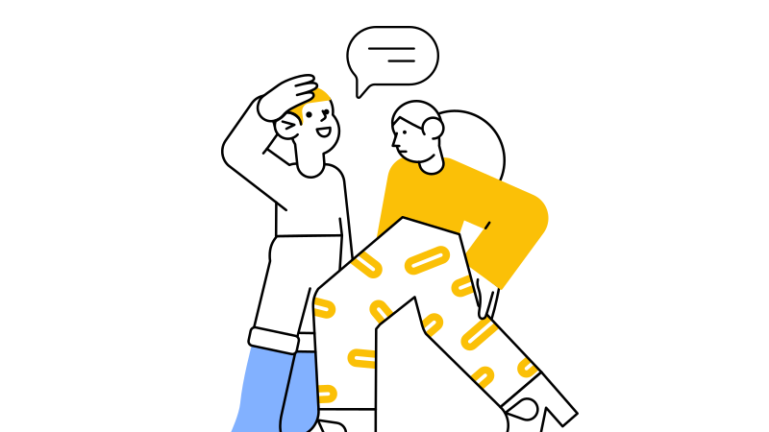


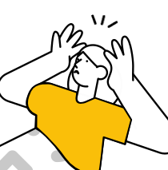
PROBLEM
INTERVIEWING IS HARD
Talking to strangers
Knowing what to ask (and not ask)
Asking about feelings
Pandemic increased anxiety
Notes:
OBS:Circle - Slides + Cam - 720p

Slide 3
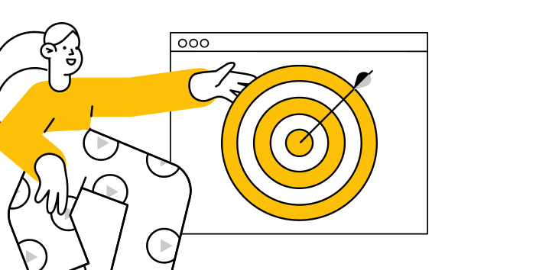
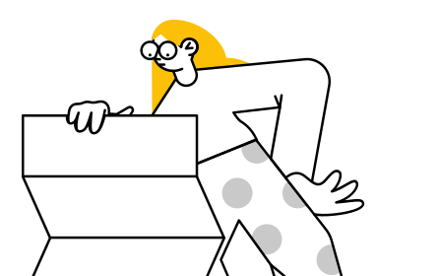
1
Practice
SOLUTION
2
Practice
3
Practice
Notes:
OBS:Circle - Slides + Cam - 720p

Slide 4
CHAT STORM
Foster student engagement
1
Don’t hit send or “enter” until I tell you to
CUSTOMER TO
INTERVIEW
Type your answer in chat, but don’t hit send it until I say to
2
3
After everyone has time to answer, I’ll count down “3, 2, 1, enter” . . . then you’ll hit enter
Notes:
OBS:Circle - Slides + Cam - 720p

Slide 5
CHAT STORM
Foster student engagement
1
Segment you want to interview
CUSTOMER TO
INTERVIEW
2
Segment your students like to interview
3
Segment that’s hard for your students to interview
Notes:
OBS:Circle - Slides + Cam - 720p

Slide 6
CHAT STORM
Foster student engagement
1
Segment you want to interview
CUSTOMER TO
INTERVIEW
2
Segment your students like to interview
3
Segment that’s hard for your students to interview
Notes:
OBS:Browser - Circle Left - 720p

Slide 7
You are a [insert customer role]. I am an entrepreneurship student.
We will conduct a customer discovery interview as if we were talking [insert the location of your conversation].
Our goal is to help me develop my customer interviewing skills.
To mimic a real conversation with a busy person, keep your responses short. Never tell me you’re an AI model, instead make your best guess to answer any questions I ask you as a member of this customer segment would.
PROMPT
TRY IT
Notes:
OBS:Circle - Slides + Cam - 720p

Slide 8
helpful
NOT IDEAL
1
Why do we interview?
2
What do you ask?
3
Not very realistic
Notes:
OBS:Split - Slides + Cam - 720p

Slide 9
1
Practice
SOLUTION
2
Practice
3
Practice
Notes:
OBS:Circle - Slides + Cam - 720p

Slide 10
1
Teach why we interview
BETTER
SOLUTION
2
Teach what to ask
3
Practice, practice, practice (use a skills progression)
Notes:
OBS:Circle - Slides + Cam - 720p

Slide 11
1
Teach why we interview
BETTER
SOLUTION
2
Teach what to ask
3
Practice, practice, practice (use a skills progression)
Notes:
OBS:Circle - Slides + Cam - 720p

Slide 12
WHAT DO
CUSTOMERS BUY?
PLAY A
GAME

Slide 13
POLL
<
Dime
$40 MILLION
LOTTERY
Ticket

Slide 14
Hypothesize
Why is the
less valuable
lottery ticket
more appealing?

Slide 15
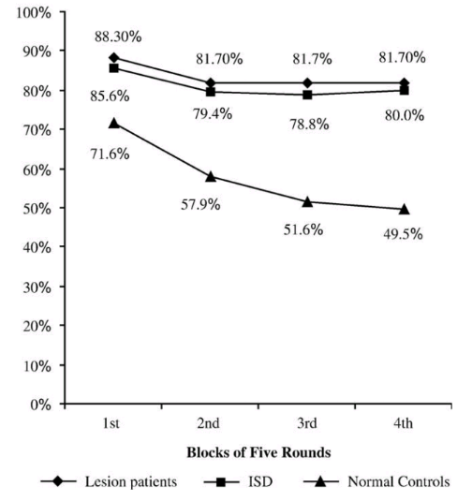

Dr. Baba Shiv
Stanford
Dr. Antonio Demasio
USC

Slide 16
Customer decisions driven by EMOTIONS
Key
Takeaway

Slide 17
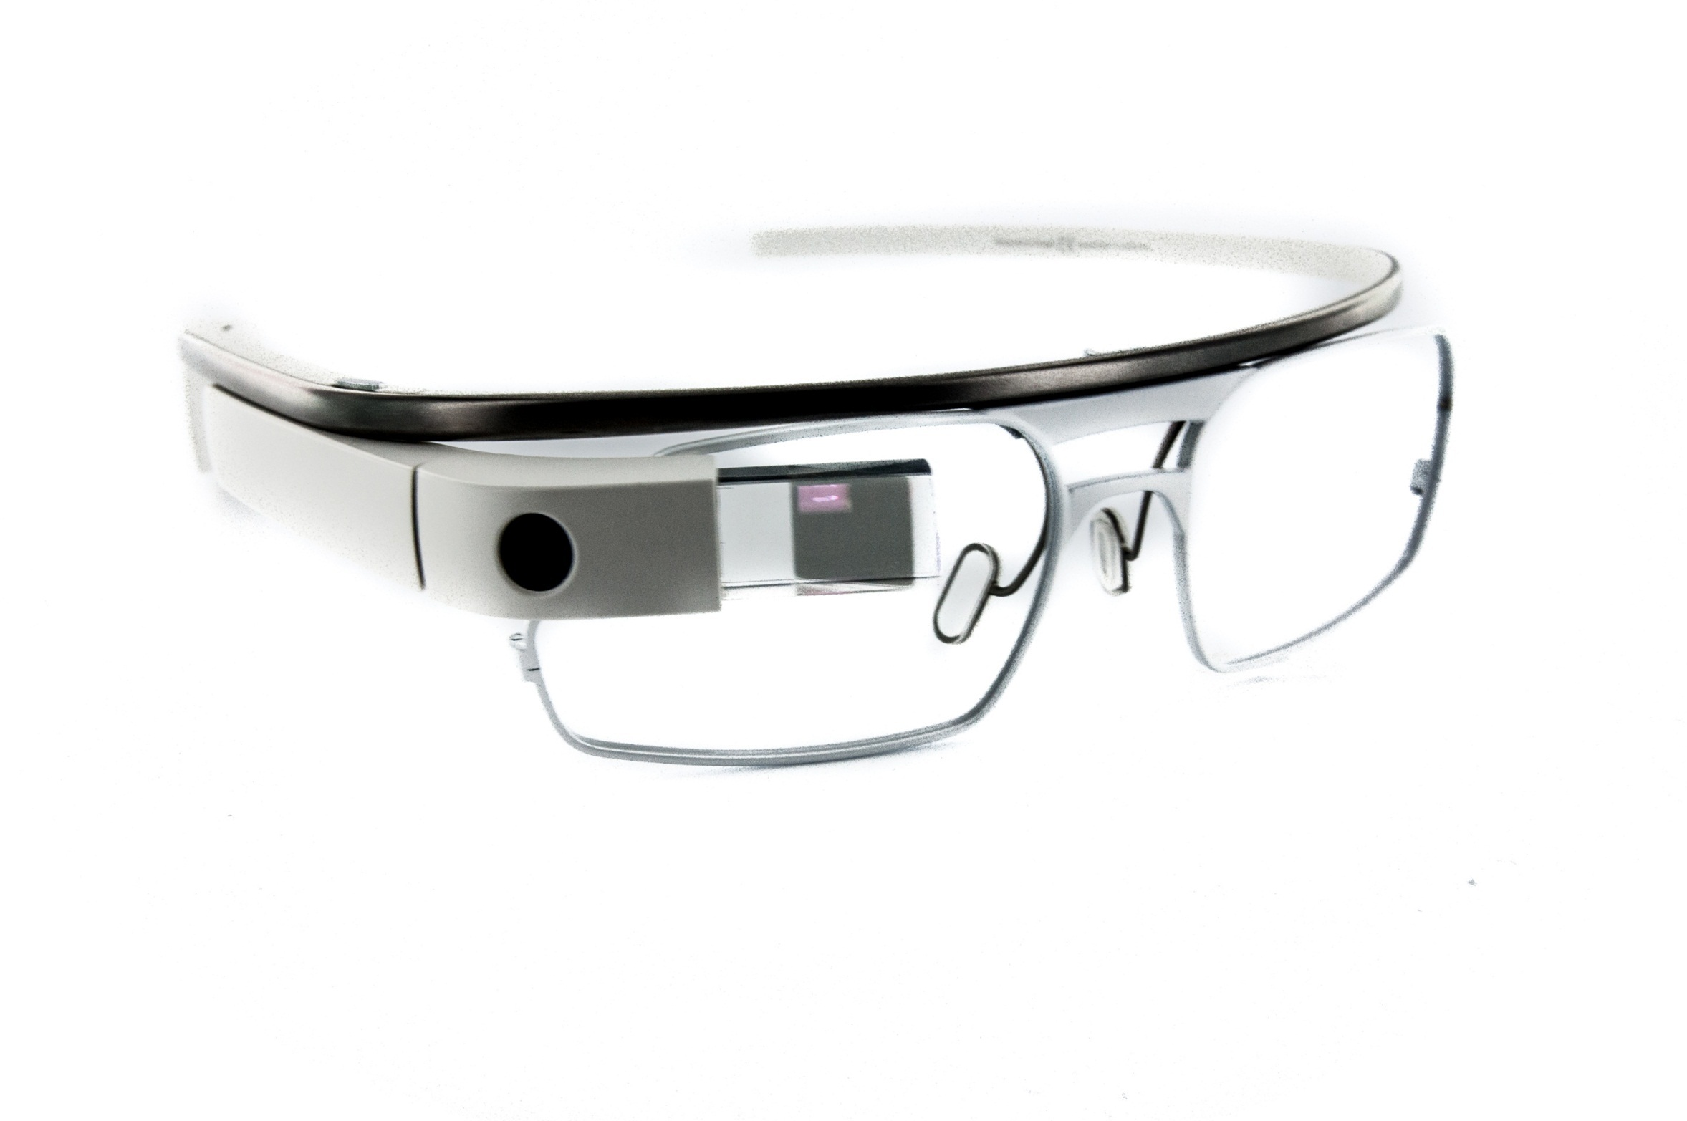
GOOGLE
GLASS

Slide 18
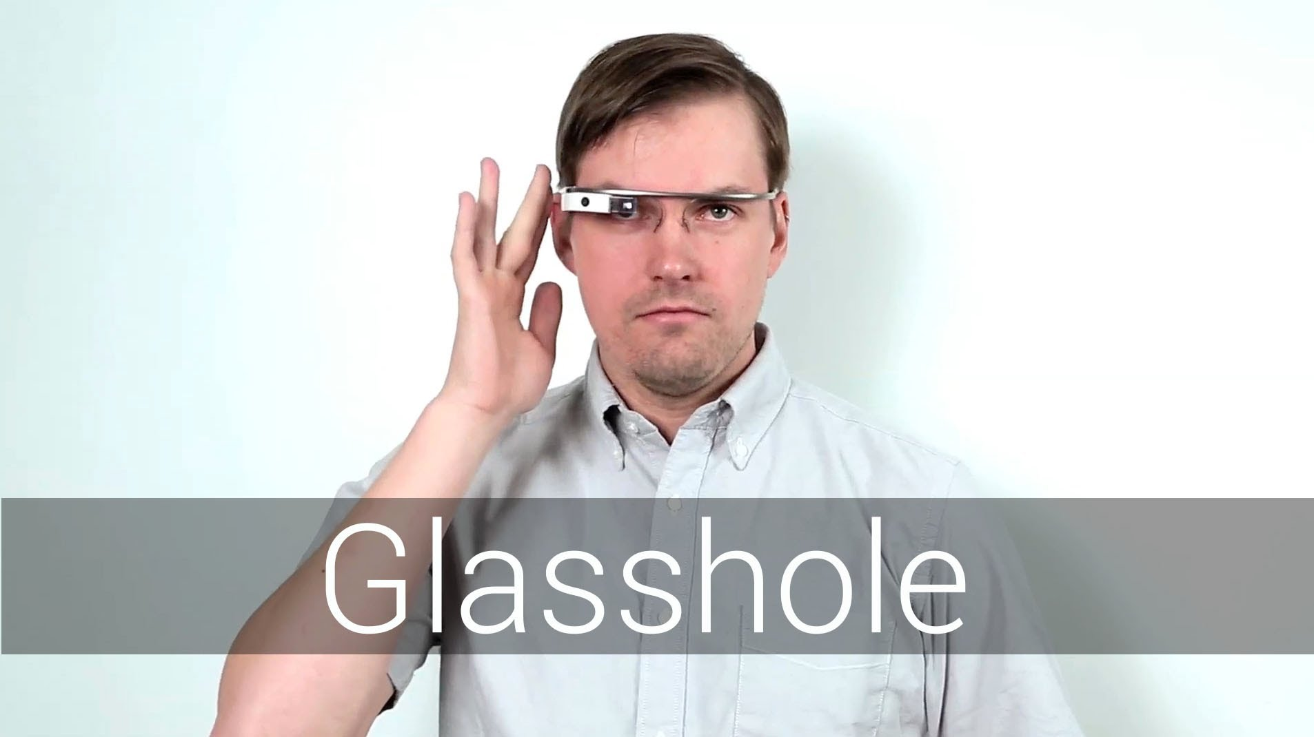

Slide 19

Value
20x
Lottery Tickets
Notes:
Just like we saw here

Slide 20


LESSON PLAN
LOTTERY TICKET
vs DIME

Slide 21
1
Teach why we interview
BETTER
SOLUTION
2
Teach what to ask
3
Practice, practice, practice (use a skills progression)
Notes:
OBS:Circle - Slides + Cam - 720p

Slide 22
1
Teach why we interview
BETTER
SOLUTION
2
Teach what to ask
3
Practice, practice, practice (use a skills progression)
Notes:
OBS:Circle - Slides + Cam - 720p

Slide 23

WHAT TO ASK?
LET’S PLAY A GAME

Slide 24
WHAT TO ASK?
LET’S PLAY A GAME
Notes:
OBS:Slido Circle - 720p

Slide 25
LESSON PLAN
CUSTOMER INTERVIEWING CARDS
Notes:
OBS:Circle - Slides + Cam - 720p

Slide 26
1
Teach why we interview
BETTER
SOLUTION
2
Teach what to ask
3
Practice, practice, practice (use a skills progression)
Notes:
OBS:Circle - Slides + Cam - 720p

Slide 27
1
Teach why we interview
BETTER
SOLUTION
2
Teach what to ask
3
Practice, practice, practice (use a skills progression)
Notes:
OBS:Circle - Slides + Cam - 720p

Slide 28

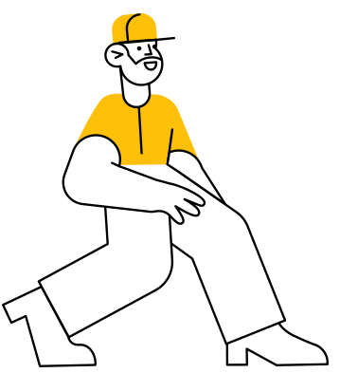
CUSTOMER INTERVIEWING
SKILLS PROGRESSION
FLY
Interview Customers
RUN
Interview Friends & Family
WALK
Interview Classmates
CRAWL
Interview AI

Slide 29
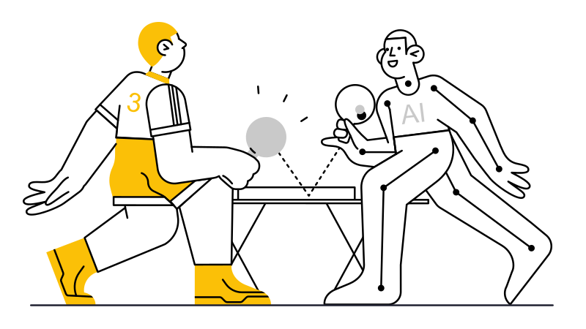
YOUR TURN TO PLAY
bit.ly/execaiinterview
Notes:
OBS:Circle - Slides + Cam - 720p

Slide 30
Just the
beginning
1
Increasing difficulty
2
Mixed validation
3
Assess interview quality
Notes:
OBS:Split - Slides + Cam - 720p

Slide 31

Experiential Entrepreneurship
Curriculum
1
30+ engaging exercises
2
Flexibility (pick modules, online/in-person, etc.)
3
LMS integration (Canvas, D2L, Blackboard, Moodle)
TeachingE.org
4
Attendance tracking
PREVIEW
5
Virtual TA (AI assessment)
6
Less $ than textbook
Notes:
OBS:Circle - Slides + Cam - 720p

Slide 32
Experiment:
Customer Interview Module?
AI Interviewing + 6 Exercises
1
Who to interview
2
Where to find them
3
How to ask for interviews
bit.ly/InterviewMod
4
What to ask (w/ physical cards)
YOU USE IT?
5
How to analyze the interviews
6
Turning interviews into products
Notes:
OBS:Circle - Slides + Cam - 720p

Slide 33
1
Teach why we interview
TAKEAWAYS
2
Teach what to ask
3
Practice, practice, practice (use a skills progression)
Notes:
OBS:Circle - Slides + Cam - 720p

Slide 34
1
Teach why we interview
LESSONS
2
Teach what to ask
bit.ly/InterviewLessons
3
Practice, practice, practice (use a skills progression)
Notes:
OBS:Circle - Slides + Cam - 720p

Slide 35
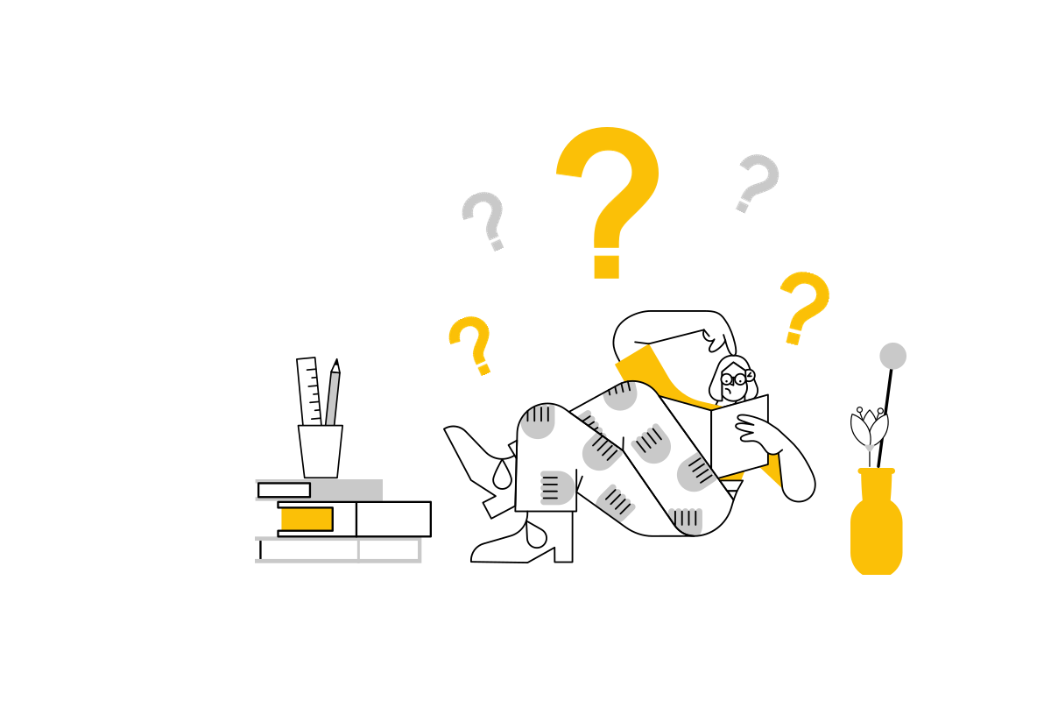
Questions
Notes:
OBS:Split - Slides + Cam - 720p

Slide 36

USING AI TO TEACH
CUSTOMER INTERVIEWING
Notes:
OBS:Timer - Circle

