Slide 1


WELCOME TO
USING AI TO IMPROVE
IDEA GENERATION
Notes:
OBS:Timer - Circle

Slide 2
WELCOME TO
USING AI TO IMPROVE
Idea generation
Justin Wilcox
Notes:
OBS:Split - Slides + Cam - 720p

Slide 3
Last Time
Using AI
To Prep for Class
Today: Using AI
In Class
Notes:
OBS:Split - Slides + Cam - 720p

Slide 4
Why AI in Class?
Using AI will become an
1
entrepreneurial skill
Your students are already
2
using AI
Notes:
OBS:Split - Slides + Cam - 720p

Slide 5

Using AI in Class
AI is great at
BRAINSTORMING
Notes:
OBS:Split - Slides + Cam - 720p

Slide 6
Using AI in Class
AI is great at
BRAINSTORMING
Notes:
OBS:Browser - 720p

Slide 7
CHAT STORM
Foster online engagement
1
Don’t hit send or “enter” until I tell you to
BRAINSTORMING
OPPORTUNITIES
Type your answer in chat, but don’t hit send it until I say to
2
3
After everyone has time to answer, I’ll count down “3, 2, 1, enter” . . . then you’ll hit enter
Notes:
OBS:Circle - Slides + Cam - 720p

Slide 8
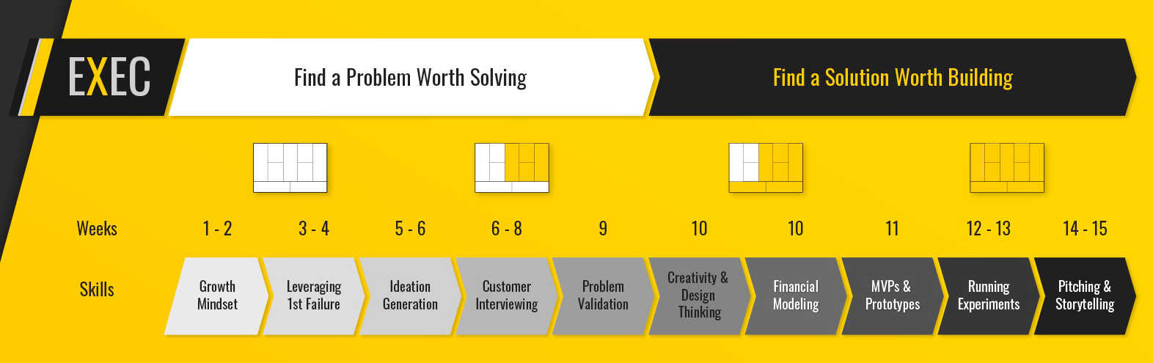
Think of...
3 Brainstorming Opportunities
Customer Storming
Notes:
OBS:Circle - Slides + Cam - 720p

Slide 9
2 Tips for
Using AI in Class
Anytime students brainstorm…
1
they should use AI
Notes:
OBS:Split - Slides + Cam - 720p

Slide 10
Think of...
3 Brainstorming Opportunities
Customer Storming
Notes:
OBS:Circle - Slides + Cam - 720p

Slide 11

TIP #2
AI is a co-pilot
not auto-pilot
Notes:
OBS:Circle - Slides + Cam - 720p

Slide 12
Let’s See it
Customer Storming
Notes:
OBS:Circle - Slides + Cam - 720p

Slide 13
CUSTOMER STORMING?
INVENTORS VS ENTREPRENEURS

Slide 14



CUSTOMER STORMING?
INVENTORS VS ENTREPRENEURS
product
problem
people

Slide 15
CUSTOMER STORMING?
INVENTORS VS ENTREPRENEURS
product
problem
people

Slide 16
CUSTOMER STORMING?
INVENTORS VS ENTREPRENEURS
people
problem
product

Slide 17

Your ideal customers
Link in chat

Slide 18
Your ideal customers
Link in chat
Notes:
OBS:Browser - 720p

Slide 19
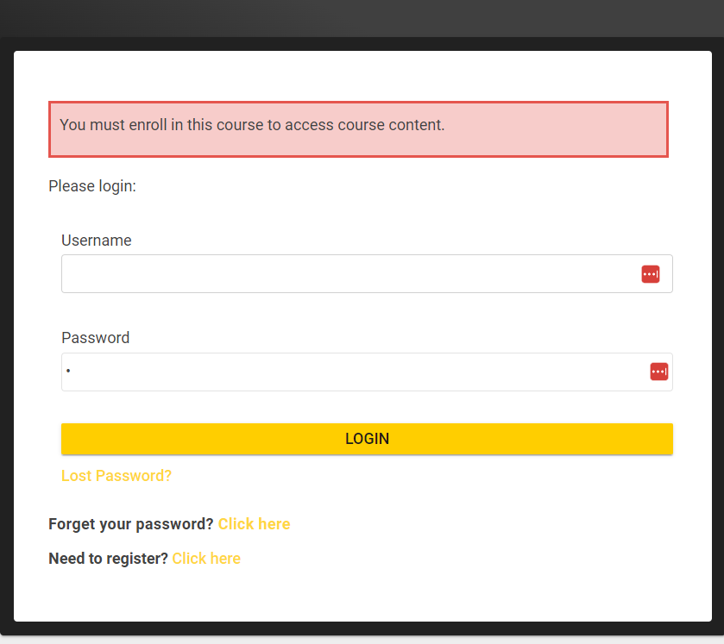
Email
Notes:
OBS:Circle - Slides + Cam - 720p

Slide 20
Notes:
OBS:Circle - Slides + Cam - 720p

Slide 21
Notes:
OBS:Circle - Slides + Cam - 720p

Slide 22
Your ideal customers
Link in chat
Notes:
OBS:Browser - 720p

Slide 23
CUSTOMER STORMING?
INVENTORS VS ENTREPRENEURS
people
problem
product
Notes:
OBS:Circle - Slides + Cam - 720p

Slide 24
CUSTOMER STORMING?
INVENTORS VS ENTREPRENEURS
emotional needs
people
product
Notes:
OBS:Circle - Slides + Cam - 720p

Slide 25
CUSTOMER STORMING?
INVENTORS VS ENTREPRENEURS
emotional needs
people
product
Notes:
OBS:Browser - 720p

Slide 26
CUSTOMER STORMING
Customer Storming
Notes:
OBS:Circle - Slides + Cam - 720p

Slide 27
Solution Ideation
Link in chat
Customer Storming
Notes:
OBS:Circle - Slides + Cam - 720p

Slide 28
Solution Ideation
Link in chat
Customer Storming
Notes:
OBS:Browser - 720p

Slide 29
Solution Ideation
Link in chat
Customer Storming
Notes:
OBS:Circle - Slides + Cam - 720p

Slide 30
MVP Generation
Customer Storming
Notes:
OBS:Circle - Slides + Cam - 720p

Slide 31
60-minute mvp
Customer Storming
Notes:
OBS:Circle - Slides + Cam - 720p

Slide 32
60-minute mvp
Customer Storming
Notes:
OBS:Browser - 720p

Slide 33
Mixo
Customer Storming
Notes:
OBS:Circle - Slides + Cam - 720p

Slide 34
Mixo
Customer Storming
Notes:
OBS:Browser - 720p

Slide 35

Lesson Plans & Prompts
bit.ly/EduAIGuide
Your Ideal Customers
Solution Ideation
60 Minute MVP
Resources from Session #1
Notes:
OBS:Circle - Slides + Cam - 720p

Slide 36
Takeaways
Anytime students brainstorm…
1
they should use AI
AI is a co-pilot, not auto-pilot
2
Notes:
OBS:Split - Slides + Cam - 720p

Slide 37
Next Steps
1
Integrate AI in your Course
Identify brainstorming exercises
Ensure co-pilot, not auto-pilot
Develop AI prompts
2
Don’t Want to Reinvent the Wheel?
Try ExEC
Notes:
OBS:Split - Slides + Cam - 720p

Slide 38

Experiential Entrepreneurship
Curriculum
AI integrated into 6 modules
1
Customer Storming
2
Solution Ideation
3
MVP Development
TeachingE.org
4
Customer Interviewing
PREVIEW
5
Financial Modeling
6
Pilot Your Purpose
Notes:
OBS:Circle - Slides + Cam - 720p

Slide 39
Experiential Entrepreneurship
Curriculum
1
30+ engaging exercises
2
Flexibility (pick modules, online/in-person, etc.)
3
LMS integration (Canvas, D2L, Blackboard, Moodle)
TeachingE.org
4
Attendance tracking
PREVIEW
5
Virtual TA (AI assessment)
6
Less $ than textbook
Notes:
OBS:Circle - Slides + Cam - 720p

Slide 40

Questions
Notes:
OBS:Split - Slides + Cam - 720p

Slide 41
Breakouts: AI in Your Classes
Highly recommend you join
Share Best Practices
But if you don’t . . .
Want to be on camera
Have a stable connection
Want to participate
Please don’t join
Notes:
OBS:Circle - Slides + Cam - 720p

Slide 42
Breakouts: AI in Your Classes
Highly recommend you join
Share Best Practices
You’ll get to . . .
Learn how others are using AI
Ask about your concerns
Please THANK your facilitator!
Notes:
OBS:Circle - Slides + Cam - 720p

Slide 43

Feedback
Notes:
OBS:Split - Slides + Cam - 720p

Slide 44
Questions
Notes:
OBS:Split - Slides + Cam - 720p

Slide 45
USING AI TO IMPROVE
IDEA GENERATION
THANK YOU!
Notes:
OBS:Circle - Slides + Cam - 720p

