Slide 1
Problems
1. Finance isn’t engaging
2. How do we share best practices?
Notes:
OBS:Split - Slides + Cam - 720p
Imagine you’re an investor.

Slide 2
Experiment
1. Demonstrate a lesson live
Notes:
OBS:Split - Slides + Cam - 720p

Slide 3
Experiment
1. Demonstrate a lesson live
Notes:
OBS:Zoom: Class + Screen

Slide 4
Experiment
1. Demonstrate a lesson live
2. Discuss 5 best practices
3. Lesson plan
Notes:
OBS:Split - Slides + Cam - 720p

Slide 5

Lesson
Financial Modeling Showdown

Slide 6
Goal
Introduce financial concepts

Slide 7
Goal
Introduce financial concepts
1st in a series

Slide 8

Who Are We?
TEACHINGENTREPRENEURSHIP.ORG
Justin Wilcox

Slide 9
Doan Winkel
Founder
Notes:
OBS:Split - Slides + Cam - 720p
Imagine you’re an investor.

Slide 10

Doan Winkel
Endowed Chair of Entrepreneurship
Notes:
OBS:Split - Slides + Cam - 720p
Imagine you’re an investor.

Slide 11
Dave Clifford
Professor (Hero)
Notes:
OBS:Split - Slides + Cam - 720p
Imagine you’re an investor.

Slide 12

Go to
https://bit.ly/tefinsurvey
Notes:
OBS:Circle - Slides + Cam - 720p

Slide 13
Notes:
OBS:Zoom: Class + Screen

Slide 14
Question
Why is Doan asking
about price, market
sizing, etc. before
teaching these
concepts?
Hint: 3 reasons
Notes:
OBS:Split - Slides + Cam - 720p

Slide 15
3 Reasons
1. More engaging to be asked, than told
2. Engaging to find out if you’re right
3. Pretesting effect
Notes:
OBS:Split - Slides + Cam - 720p

Slide 16
Question
Why did Doan ask
students to move to
different sides of
the class room?
Hint: 3 reasons
Notes:
OBS:Split - Slides + Cam - 720p

Slide 17
3 Reasons
1. Interact with different students
2. Get students away from devices
3. Increase competition & comradery
Notes:
OBS:Split - Slides + Cam - 720p

Slide 18
Question
Why isn’t Doan having
a class-wide
discussion
immediately after
each question?
Hint: 4 reasons
Notes:
OBS:Split - Slides + Cam - 720p

Slide 19
Think Pair Share
1. Time to reflect
2. Practice verbalizing
3. Positive feedback
4. More participation
Notes:
OBS:Split - Slides + Cam - 720p

Slide 20
THANK YOU
John Carroll University
Notes:
OBS:Split - Slides + Cam - 720p
Imagine you’re an investor.

Slide 21
Experiment
1. Demonstrate a lesson live
2. Discuss 5 best practices
3. Lesson plan
Notes:
OBS:Split - Slides + Cam - 720p

Slide 22
Breakouts: Best Practices
Alpha order by 1st name:
Where you teach
Share LinkedIn profile URL
1 best practice you liked (can repeat)
Repeat for adaptations / changes
Please thank your facilitator!
Notes:
OBS:Circle - Slides + Cam - 720p

Slide 23
Best Practices
1. Game to engage
2. Physically move
3. Think. Pair. Share.
4. <5 min talking at a time
5. Pretesting
Notes:
OBS:Split - Slides + Cam - 720p
Imagine you’re an investor.

Slide 24

Coming Up
Notes:
OBS:Split - Slides + Cam - 720p

Slide 25
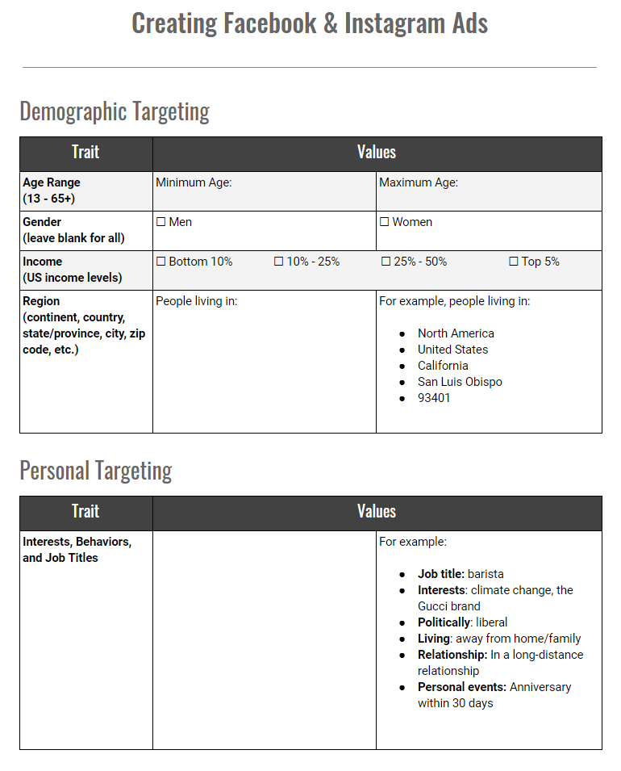
Lesson Plan
Notes:
OBS:Split - Slides + Cam - 720p
Imagine you’re an investor.

Slide 26
When to Use It
Notes:
OBS:Split - Slides + Cam - 720p
Imagine you’re an investor.

Slide 27
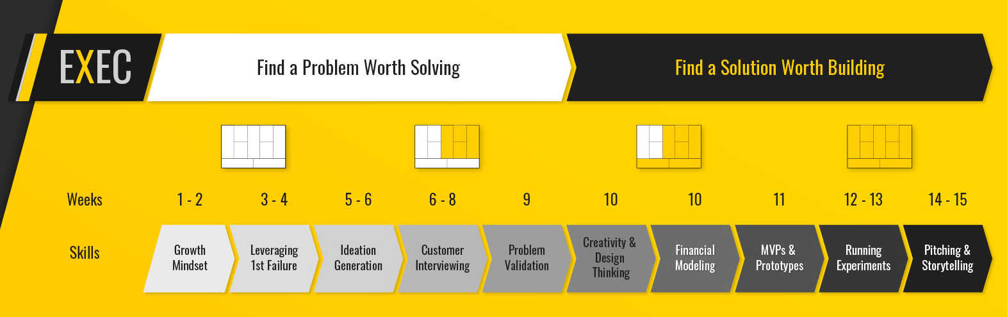
Structured Curriculum
Notes:
OBS:Circle - Slides + Cam - 720p

Slide 28
Notes:
OBS:Circle - Slides + Cam - 720p

Slide 29
Here
Notes:
OBS:Circle - Slides + Cam - 720p

Slide 30
Preview: TeachingE.org
Notes:
OBS:Circle - Slides + Cam - 720p

Slide 31


Now Available
Preview:
TeachingE.org
Notes:
OBS:Split - Slides + Cam - 720p
Imagine you’re an investor.

Slide 32
Lesson Plan
Notes:
OBS:Split - Slides + Cam - 720p
Imagine you’re an investor.

Slide 33

Feedback
Notes:
OBS:Split - Slides + Cam - 720p

Slide 34
Questions

Slide 35
Questions
bit.ly/tequestions

Slide 36
Questions
bit.ly/tequestions
Notes:
OBS:Slido Circle - 720p

Slide 37

Teaching Live
Financial Modeling Showdown
Notes:
OBS:Split - Slides + Cam - 720p

Slide 38

Notes:
OBSDEF:Split - Slides + Cam – 720p
OBS:Timer - Circle

